Slide 1
Abstract
Breast cancer tumors have inherently heterogeneous cell types that respond differently to treatments. Although there is a wealth of studies describing canonical cell signaling networks, little is known about exactly how these networks operate in different cancer cells and treatments.
This project proposes a method to further the analysis and understanding of dynamics of gene regulatory networks in the setting of HER2 over-expressed breast cancer experiments.
Dynamic responses to different targeted treatments are dissected into their common and specific parts using Robust Principal Component Analysis. A candidate model for the underlying linear time-varying dynamics is inferred with the same algorithm.
The method is tested on synthetic data, and an assessment is done on gene expression data from SKBR3 breast cancer experiments.
Ultimate aim is to use the technique to analyze common responses to understand the shared properties of different cancer cells and do network inference, and the specific responses to hint at what targeted treatments can be combined to persistently knock down a whole cancer tumor.
The intuitive tuning and efficient computation of the method make it a viable candidate for analysis of high-dimensional data sets in a cloud interface. Hence, we are developing a visualization interface to improve the impact of the technique.

Slide 2
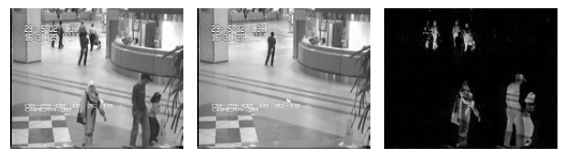
Robust Principal Component Analysis can split a data set of different experiments (or images here) up into its common and specific parts
Key idea Robust Principle component analysis
Suppose we are given a large data matrix M, and know that it may be decomposed as M = L + S , where L has low-rank and S is sparse.
RPCA algorithm:
Application: Video Surveillance. Data M are the pixel values of images from a video stream
Time
Low rank information in L corresponds to repeating pixels of background in video stream
Sparse information in S corresponds to changing pixels due to movement in the video stream
Source: Candes et. al, Journal of the ACM, 2011

Slide 3
Key idea of applying RPCA to Heterogeneous Cancer Dynamics
Experiments on different cell lines/with different drugs
P
P
P
M
EGFR
EGFR
EGFR
LAP
AKT
P
P
P
AKT
AKT
AKT
AKT
AKT
AKTi
S6
P
P
P
S6
S6
S6
S6
S6
Disentangle the common and specific responses
Common respon- ses = “low-rank” data component
Specific response = “sparse” data component
P
P
P
P
M
EGFR
EGFR
EGFR
EGFR
LAP
AKT
P
P
P
P
AKT
AKT
AKT
AKT
AKT
AKT
AKT
AKTi
S6
P
P
P
P
S6
S6
S6
S6
S6
S6
S6
Use common responses as a robust input for data-driven network inference
Use specific responses to analyze sensitivity of heterogeneous cell lines to different drugs
Main limitation: our data is not a direct addition of low-rank and sparse component, they are “entangled” by dynamics in the network (propagation)

Slide 4
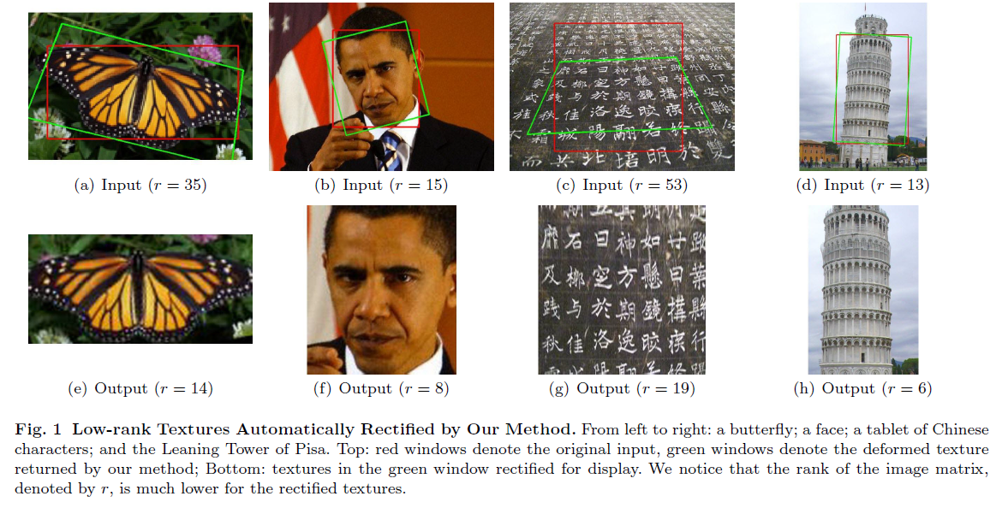
How to disentangle our cancer treatment responses? Use Transform Invariant Low-rank Textures (TILT)
Key intuitive idea
Imagine images of the same object taken from different angles
Comparing them with RPCA as before now does not work
TILT algorithm allows images to rotate/translate, in order to “align” them and then find the commonalities and specificities
Aligning images = finding and undoing the inverse transformation of the images with respect to the common orientation
This inverse transformation provides information about orientation of object on the picture
Source: Zhang et. al, International Journal of Computer Vision, 2012
Notes:
To eliminate the ambiguities in scaling the coordinates,
we enforce (only for affine transformations) that the
area and the ratio of edge length remain constant be-
fore and after the transformation,
Local geometry, Constraints on Scale

Slide 5
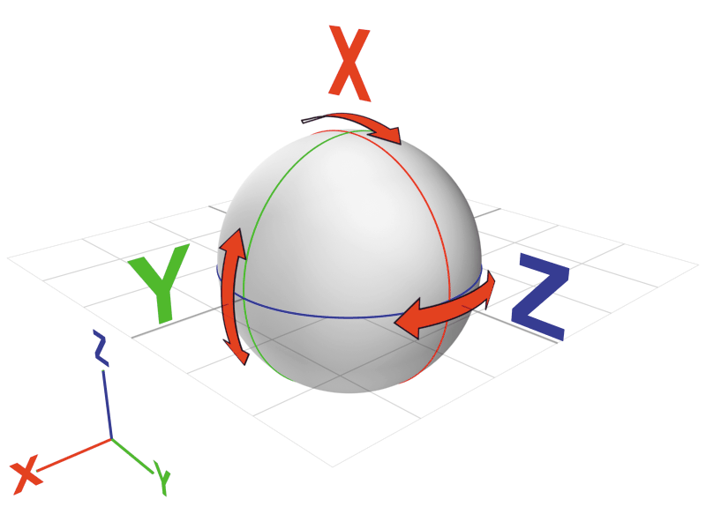
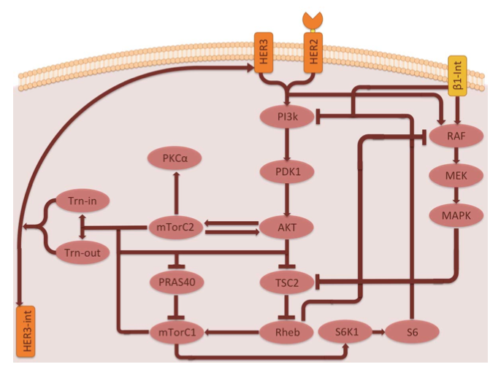
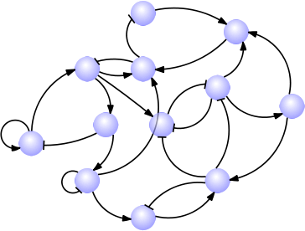
Instead of finding the inverse rotation for images, we find the inverse dynamical transformation for spatio-temporal gene expression data
Rearranging images to align them, as analog to…
Data: rotated/slanted images
Find the inverse rotation/translation
Result:
Matching images
Orientation of objects
… Reversing dynamics in protein expression data to disentangle common and specific responses
Data: protein expressions
Common responses and specific responses are entangled by dynamics (as analog to rotation/translation)
Find inverse dynamical transformation
Result:
Disentangled common and specific responses and to be analyzed separately
Dynamical model explaining dynamical relations between proteins over time

Slide 6
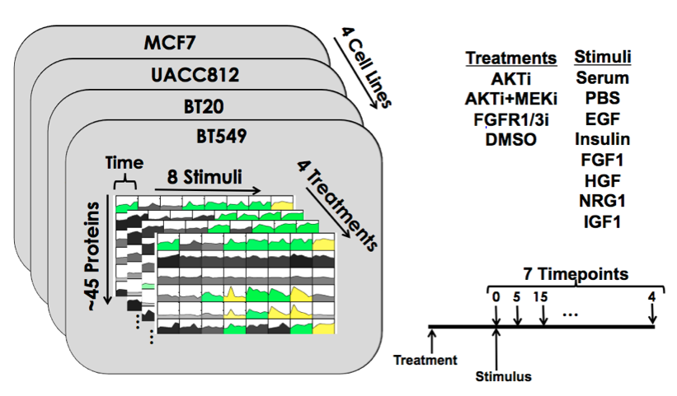
The TILT inspired algorithm retrieves information about network dynamics and specific responses by parameterizing a dynamic model
Analogy between experiments and mathematical abstraction of the data and dynamics
Experimental setting
Starting condition cell
Targeted drug/ stimulus
Heterogeneous pathways
Experimental observations
Systems abstraction
analog
Initial state
Input
Dynamic transformation
Resulting data is an “entangled” transformation of the input and initial state
Algorithm to retrieve model and hence “disentangle” the common and specific responses: and
“Undoing” the dynamical transformation improves splitting of common and specific responses

Slide 7
The algorithm was tested on a SKBR3 experimental dataset
Assessment of algorithm on SKBR3 data set
Analysis approach
Modeled subnetwork
3 SKBR3 cell lines: mCh, E545K, H1047R
2 treatments: DMSO, Lapatinib
Hypothesis: mutants with hyper-activated PI3K are less susceptible to Lapatinib → AKT less down-regulated
Model sub-network of 6 proteins: pHER2, pHER3, PI3K(p85), PDK1(pS241), AKT(pS473, pT308)
Analyze common and specific dynamics
Relate findings back to hypothesis

Slide 8
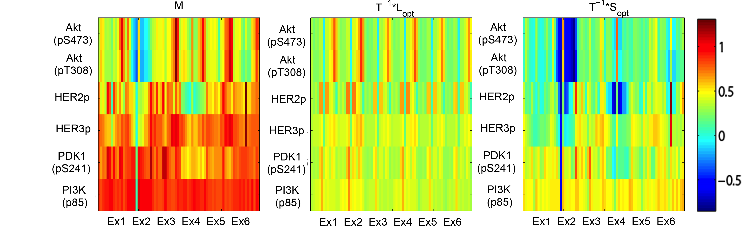
Findings support biological hypothesis about hyper-activation of PI3K
Assessment of algorithm on SKBR3 data set
Observations
Down-regulation of AKT in wild type picked up as a specific response
Over-activation PI3K picked up as a specific response
Algorithm finds a good candidate for the common responses over different experiments (notice the pattern in common responses) → useful for network inference
1
2
3
Original data
Common response
Specific response
Ex1: mCh/DMSO, Ex2: mCh/Lap, Ex3: E545K/DMSO, Ex4: E545K/Lap, Ex5: H1047R/DMSO, Ex6: H1047R/Lap

Slide 9

Conclusions and Future Work
Conclusions and Future Work
New data analysis and dynamic modeling technique is able to disentangle spatio-temporal gene expression data from heterogeneous cancer experiments into its common and specific responses, and retrieve a dynamic model for (part of) the common signaling pathway
Common responses can serve to understand shared properties of different cancer cells and do network inference
Specific responses can hint at what targeted treatments can be combined to persistently knock down a whole cancer tumor
Developing cloud computing interface for analytics
Adjust lambda parameter, normalization…
The limited number of tuning parameters make it a promising method for clinical data analysis through cloud based services

